Slide 1
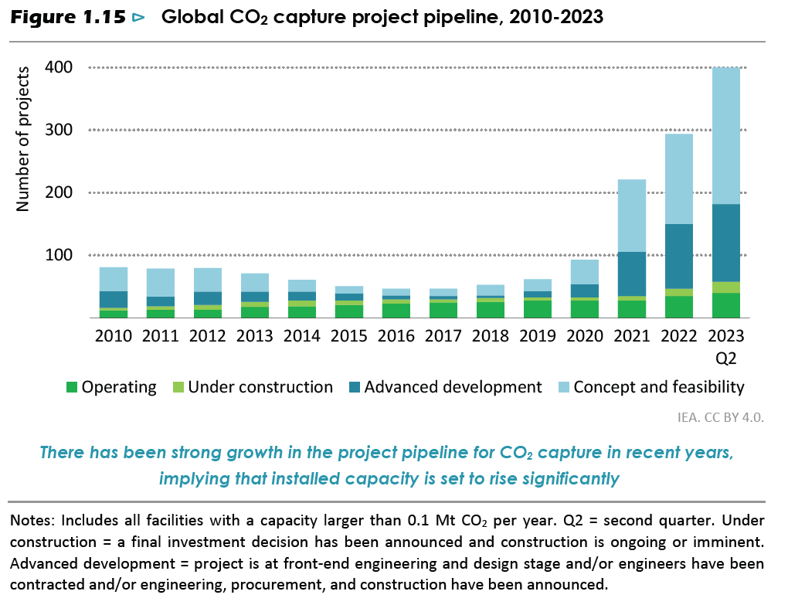
Potential overestimate of contribution of CCS in IEA projections

Slide 2
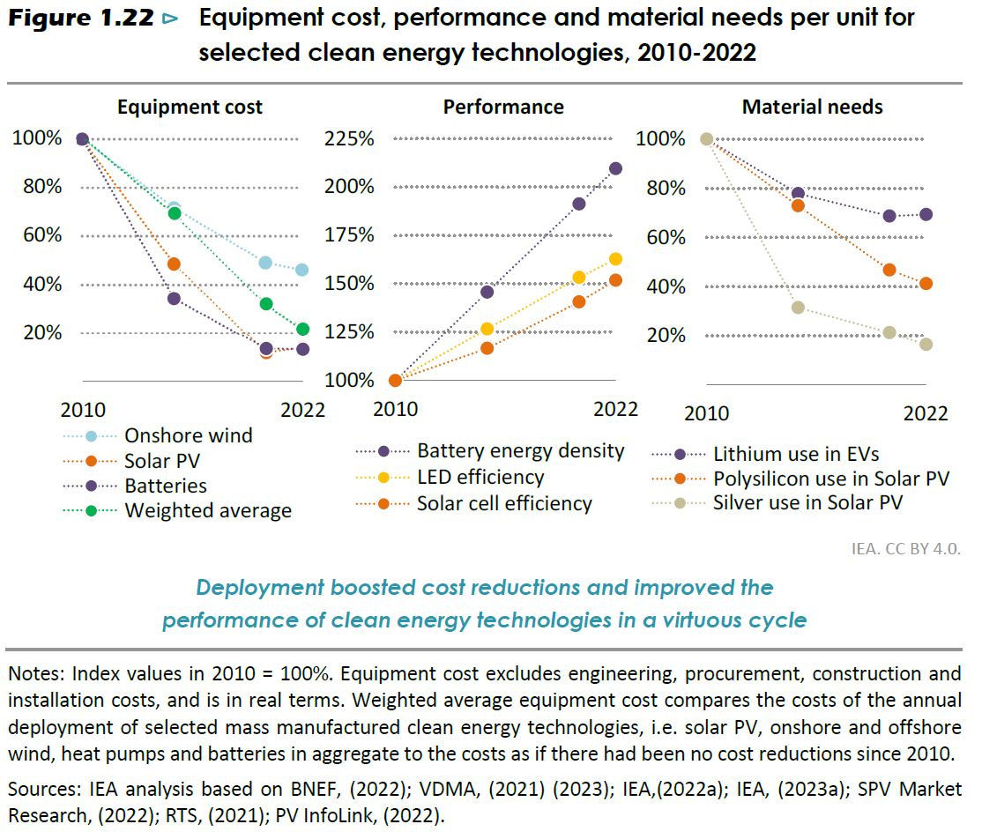
Renewable cost/price reductions are slowing down

Slide 3
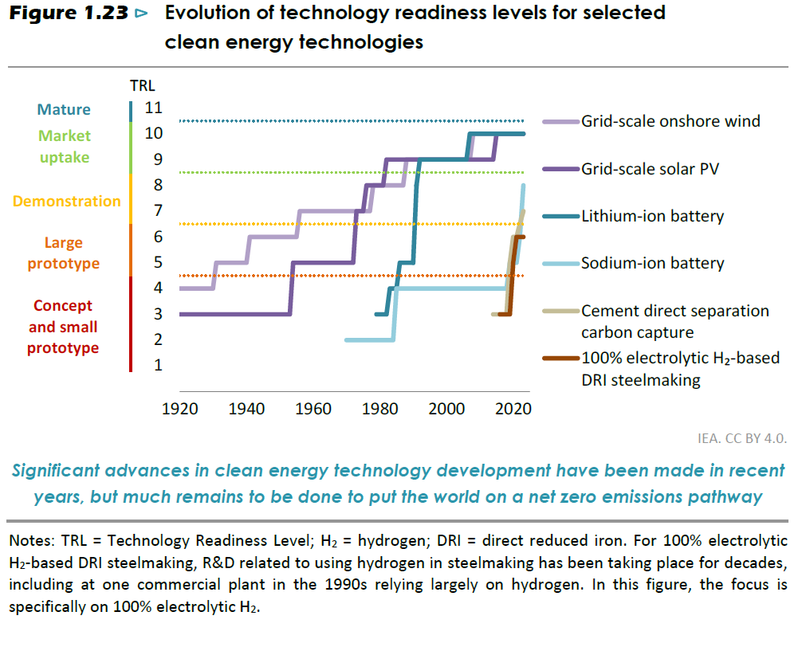
Many important technologies not yet market ready

Slide 4
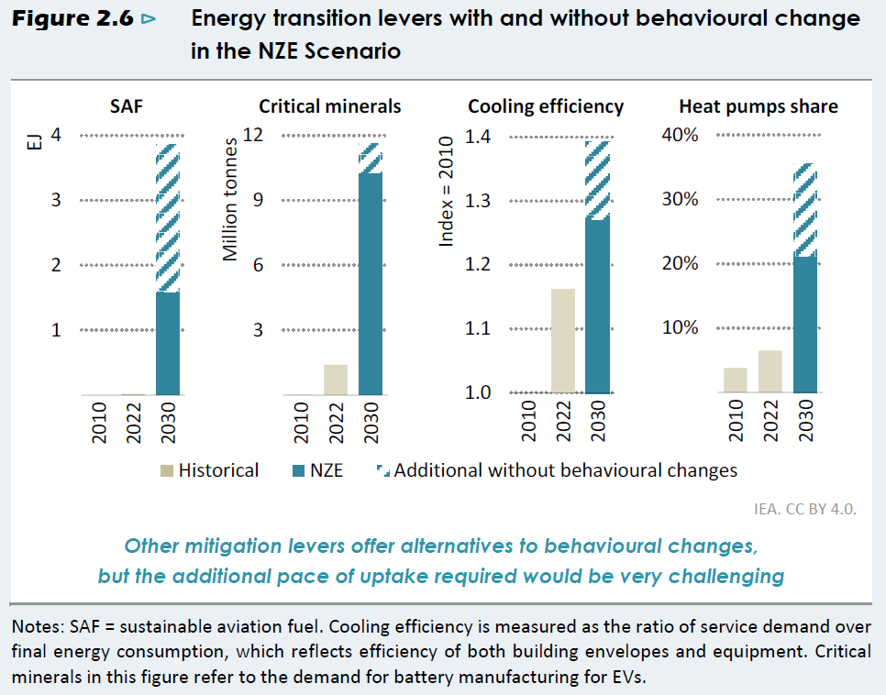
Significant reliance on behavioural change in NZE scenarios

Slide 5
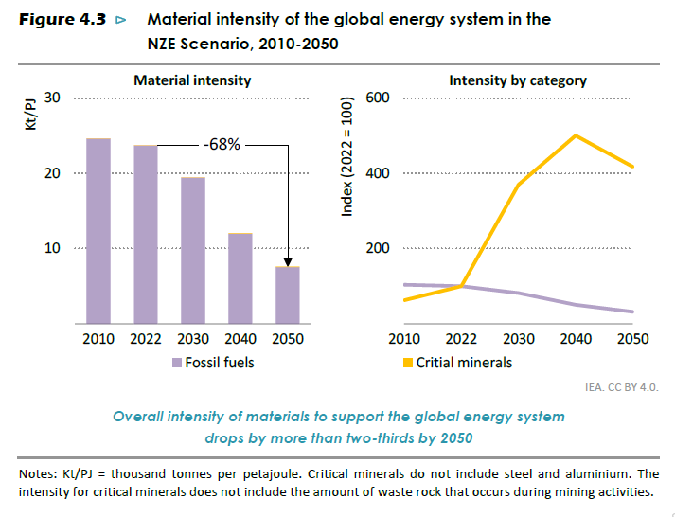
While overall material intensity drops, critical mineral intensity increases

Slide 6
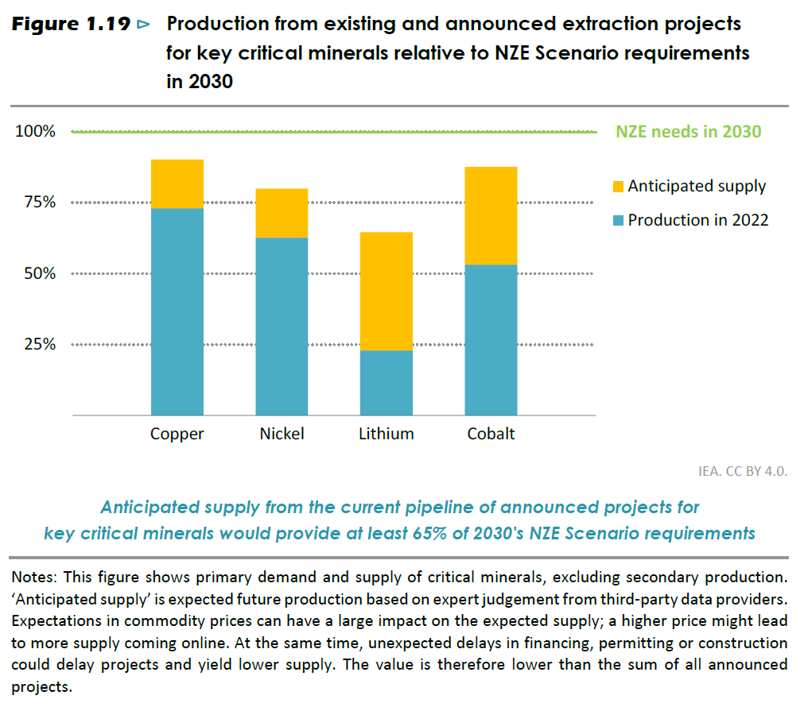
Demand for critical minerals not met by expected supply in NZE

Slide 7
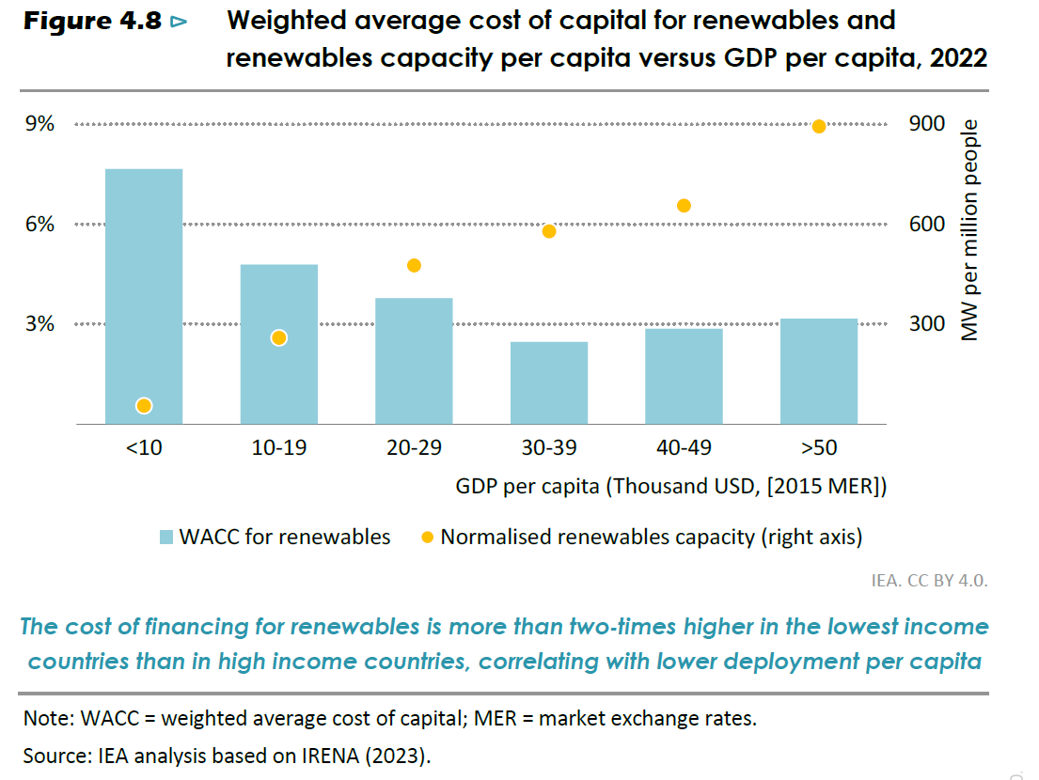
Financing costs significantly higher in poorer regions

Slide 8
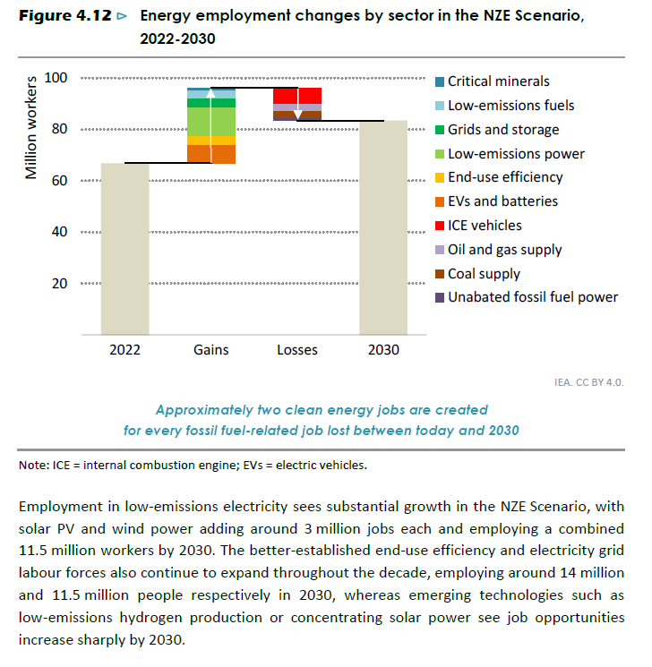
While employment increases overall, there are still significant numbers of jobs lost in fossil fuel industries, with some countries harder hit than others.

Slide 9
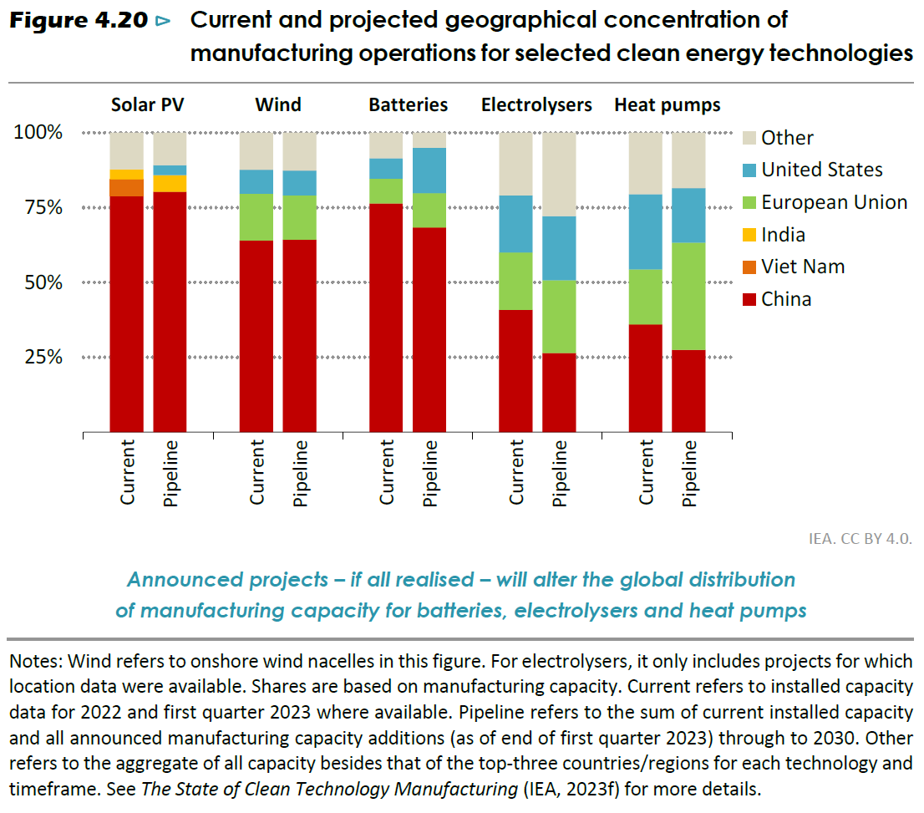
Green energy transition reduces shifts energy dependency from OPEC countries to China

